Slide 1


&
Spreading love and decentralization

Slide 2


Tokens
$eLOVE & $cLOVE

Slide 3
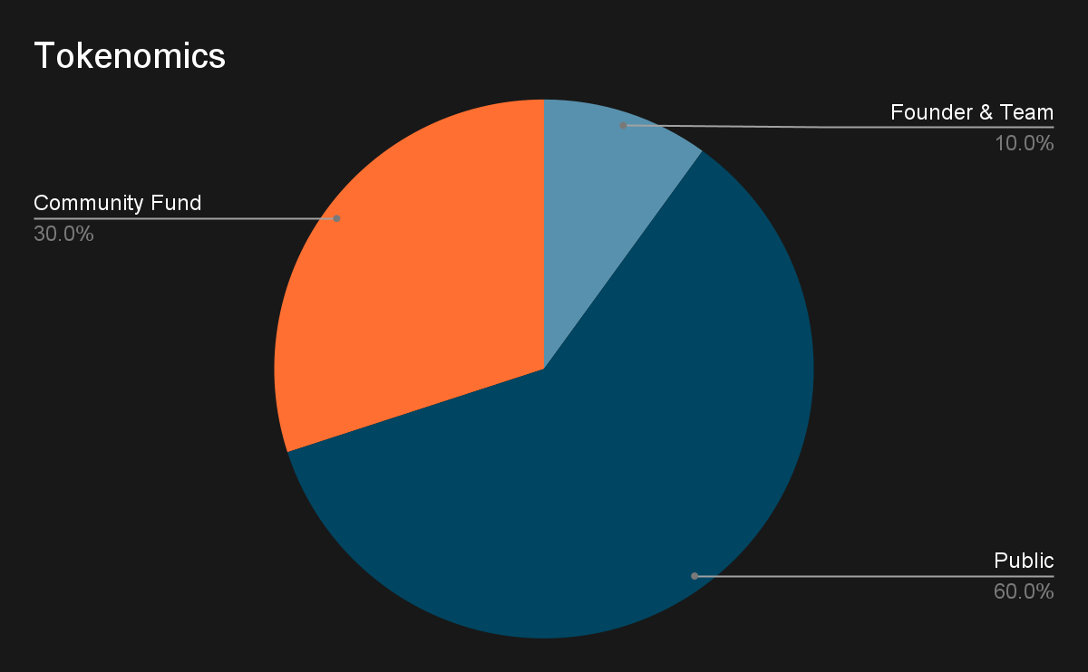
Tokenomics
90% of tokens will be allocated to the public while 10% of tokens will be allocated to Core Team members.
Supply: 2,000,000,000

Slide 4


Ergo Love Initial Tech Stack
Ergo JS Library
UI
ErgoScript
ErgoAPI
Ergo-Subpooling
MySql/Postgres
You’re welcome for the new logo ;)

Slide 5
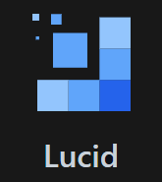
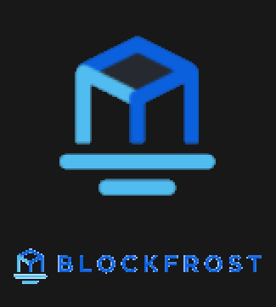
Cardano Love Initial Tech Stack
UI
Cardano JS Library
API

Slide 6
Ergo Love Project Ideas
Token: (cLove, eLove) ~ (cTosi, eTosi) ~ same tokenomics
Create an eLOVE faucet dapp where users can send ergo to receive love tokens, Users are incentivised to send Love to friends/family/anyone they want to give love to, the more wallets added the more love tokens distributed and rewarded to the user.
Create a dapp where users can rate a company, nft community, dao, or anything.
The user sends anywhere from either (1-10) or maybe (1-100) $Love tokens based on what rating they want to give that object, 1 per wallet.
Show the statistics of the love ratings for each dex/dapp/nft.
The love tokens sent will be sent to a wallet for a community fund, to be controlled by the community.
Create a subpool for love tokens like on /GetBlok.io, except probably on Ergo Love mining pool to further decentralize Ergo.
Encourage new pools to open up by allocating them eLOVE tokens to distribute to their miners to help increase hash rate on LHR pools.
Encourage other Ergo Tokens to distribute tokens to LHR pools so they can distribute them to their miners by setting up their own subpools.
Charity SubPools to assign hashrate that you want to donate to any charities, projects, people in need, like gofundmergo.

Slide 7
Cardano Love Project Ideas
Main mission is to further decentralize Cardano and reward people for delegating with small single stake pools.
Create low fee Stake Pool and reward cLove to people who delegate to CSPA stake pools with less than ~1.5million, once 1.5 million has been reached, cLove rewards will be diminished until x amount, with exception of maybe the cLove pool.
Encourage other projects to distribute tokens similarly to help decentralize cardano and spread the love in order to create more block producing nodes and further decentralize cardano.
Create a dapp where users can rate a company, nft community, dao, or anything, perhaps cLOVE and eLOVE eventually merge with rosenbridge? 1-10(or 1-100) For now thinking the ratings will separate between Cardano and Ergo.
Create a cLOVE faucet dapp where users can send ergo to receive love tokens, Users are incentivised to send Love to others, the more wallets added the more love tokens distributed and rewarded to the user.
Portion of any proceeds go to charity of communities choosing, as well as a community fund.

Slide 8
Current Progress
In the process of configuring bare metal Cardano testnet relay using CardanoBSD, finishing setup on the testnet relay and get my other relays setup on testnet.
Once testnet is complete and I am confident in the setup, I will transition to mainnet, I will also keep a testnet relay or two going to help decentralize testnet a little, and also to test of course.
Frameworks selected for Ergo/Cardano and react template selected for Ergo Mining Dashboard as a starting point.
Researching Ergo mining pool configuration.
Researching ErgoJS and ErgoScript, this was my first experience with Ergo development had no exposure, didn’t really get enough time to dive into it. But I see that I can learn a lot from the subpools github and work with them and getblok.io as our goals align.

Slide 9
Relevant Experience
Bachelors of Science in Computer Science
4 years of industry experience as full stack developer and system administrator.
Linux/Wintel administrator for multiple production applications responsible for full project lifecycle. Creating, Installing, Configuring, Deploying, etc.
~10 years of development experience, multiple websites for school and work projects.
Languages: C#, JavaScript, Java, C, PHP, SQL… and more

Slide 10
Final thoughts
I didn’t have a whole lot of time to develop but I did a lot of research and requirements gathering and will begin to mvp all the pages for the project. I have been thinking about this project for a little while now, and purchased the servers for stake pool/mining pool. TosiHack happened to come up so I figured it was the perfect opportunity, especially when I read the description where the team said they are familiar with building on both chains and can help out and manage some of the difficult parts. With their support and experience and my technical knowledge, as well as a little help from the community of course. I think we can spread a lot of love and further decentralize both chains.
Thank you for your time, any suggestions are welcome, please reach out.

Slide 11
Contact:
Name: Josh
Email: Onthemoonmanllc@gmail.com
Twitter: https://twitter.com/cardanolove & https://twitter.com/ergolover
Discord: Onthemoonman#1554
If you want my linkedin DM me.

